Slide 1
Operating Systems for Underwater Wireless Sensor Networks
Peter Tueller

Slide 2
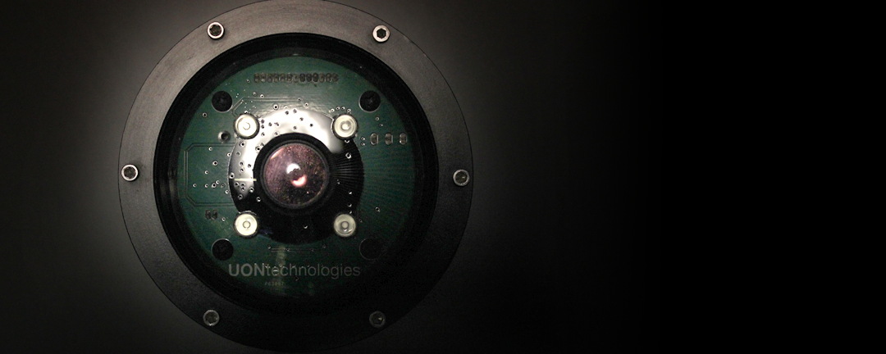
Agenda
Background
Operating System Fundamentals
Implementation
Measurements and Benchmarking
Results and Future Improvement
Conclusion
Questions

Slide 3
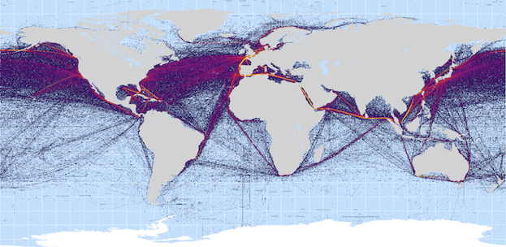
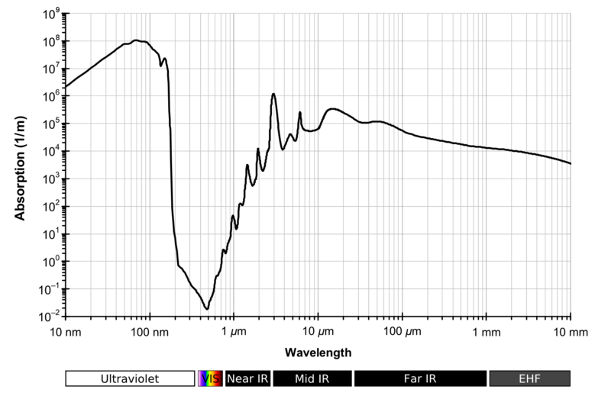
Background
Environment
Economy
AUV
Acoustics
Optical Modem Modules
Networking
Notes:
Source: http://cdn.thewire.com/img/upload/2012/07/20/shipping_lanes2.png
Source: https://en.wikipedia.org/wiki/Electromagnetic_absorption_by_water

Slide 4
Bare-Metal

Slide 5
Operating System Fundamentals
Tasks
Interrupts
Context Switching
Embedded Applications

Slide 6
Implementation
ARM Architecture
Execution Modes
Stack Pointers
Service Calls
System Tick Timer
Queue
Mutex/Semaphore

Slide 7
Measurements and Benchmarking
Loaded vs Unloaded Systems
Interrupt Latency
Context Switching Latency
Environmental Characterization

Slide 8
Results and Future Improvement
Unloaded System
Loaded System
Race Conditions
Higher Bandwidth
Scheduling

Slide 9
Conclusion
High performing, low-power, high bandwidth system
MQX Lite, eCos, FreeRTOS
Proof of Concept

Slide 10
Questions?

